Slide 1
SAMPANN Comprehensive Pension Management System
BSNL Voluntary Retirement Scheme 2019 via SAMPANN

Slide 2
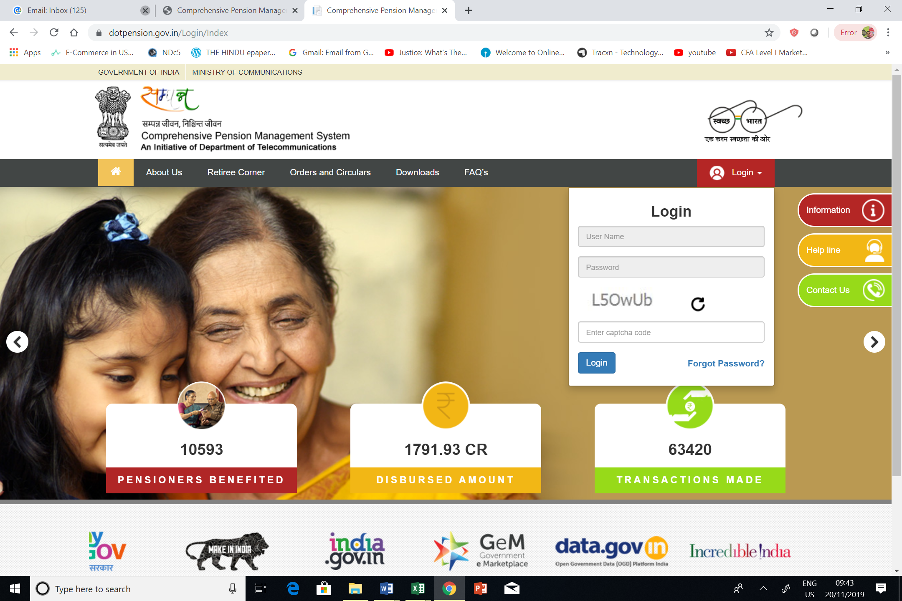
Retiree Login
Retirees must ensure that their latest and active mobile numbers are available in BSNL’s ERP system.

Slide 3
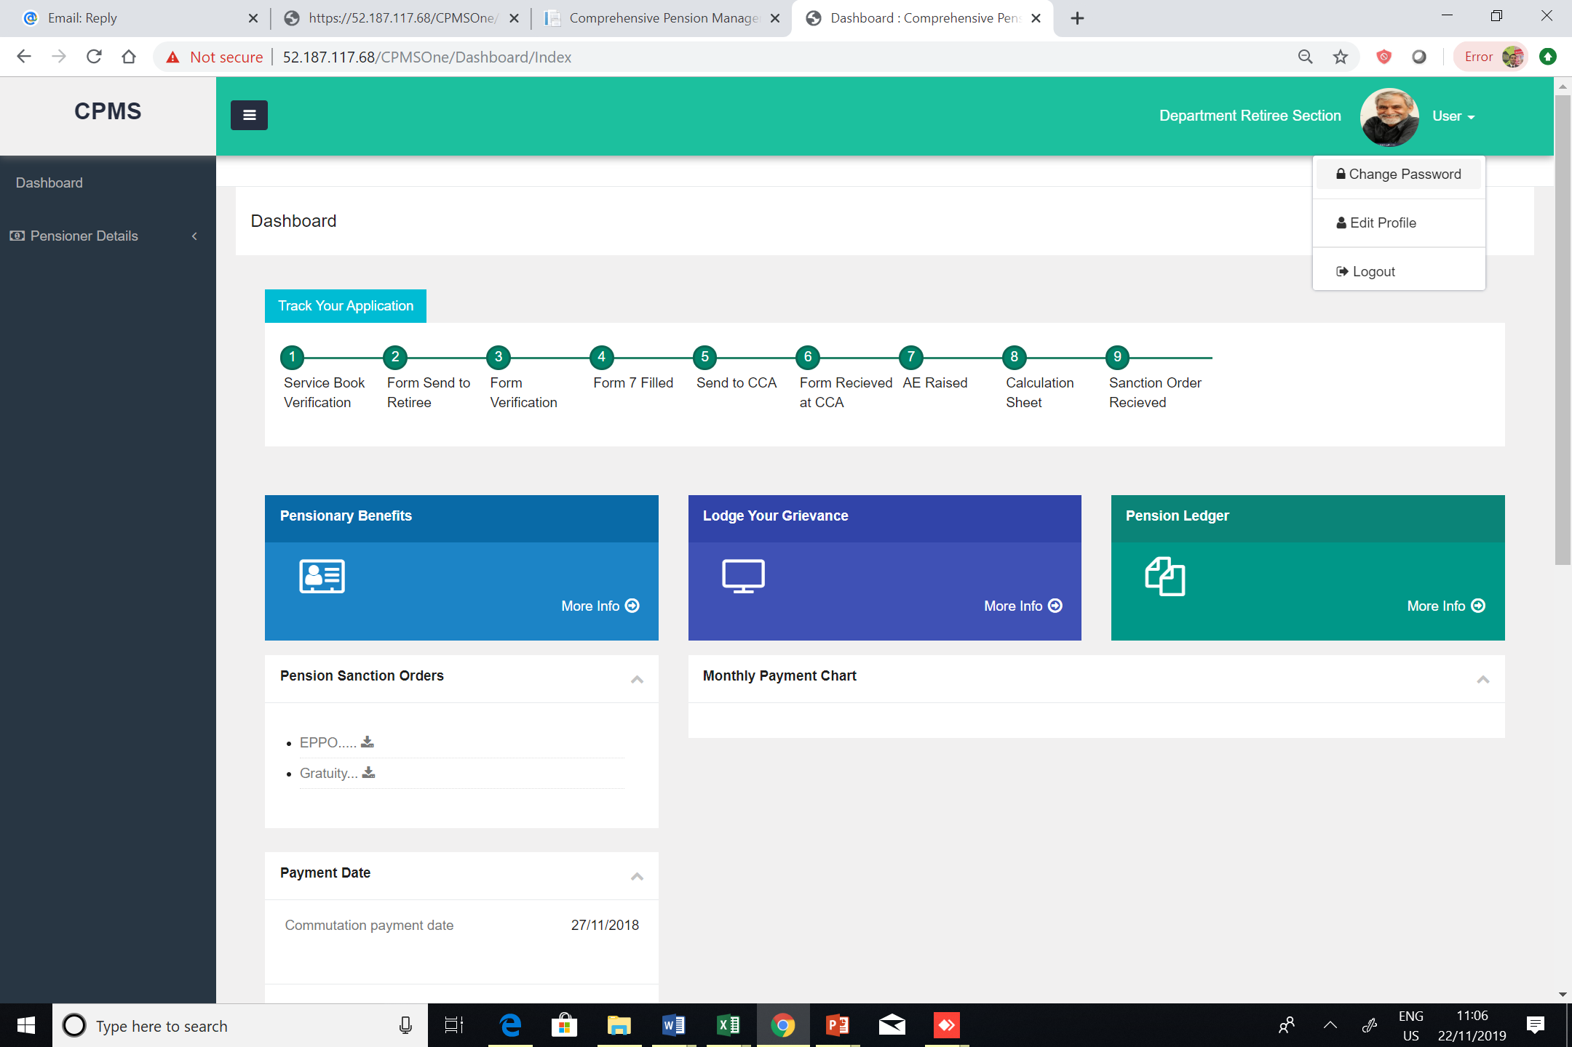
Password Change
After logging in for the first time, the retiree should change his/her password immediately.

Slide 4
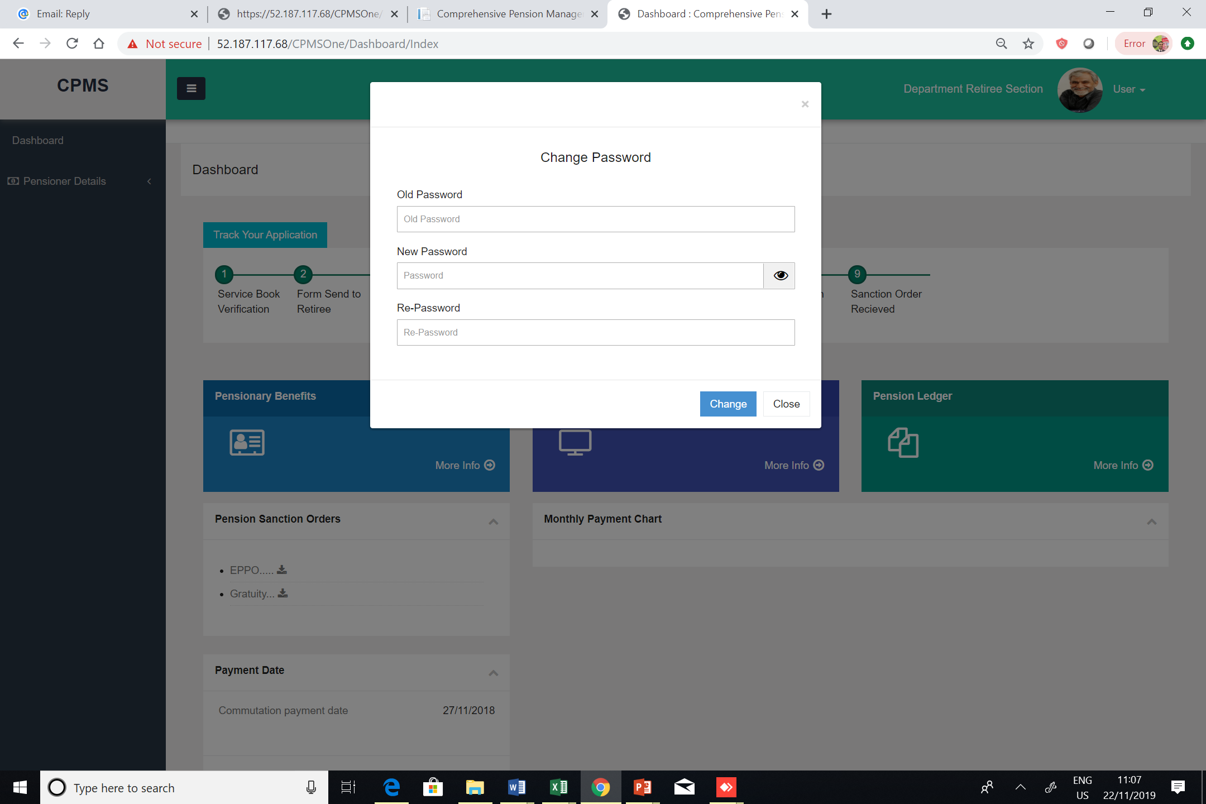
Password Change

Slide 5
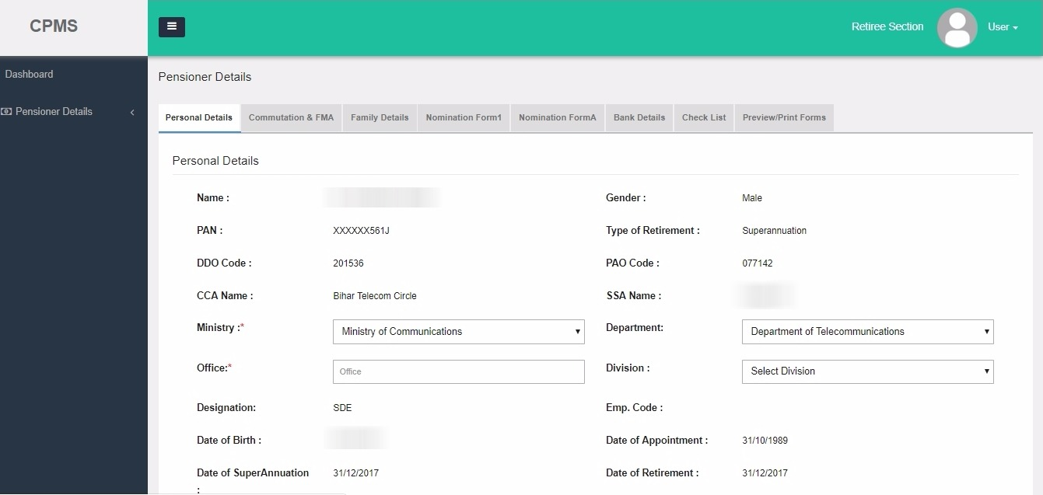
Personal Details Tab

Slide 6
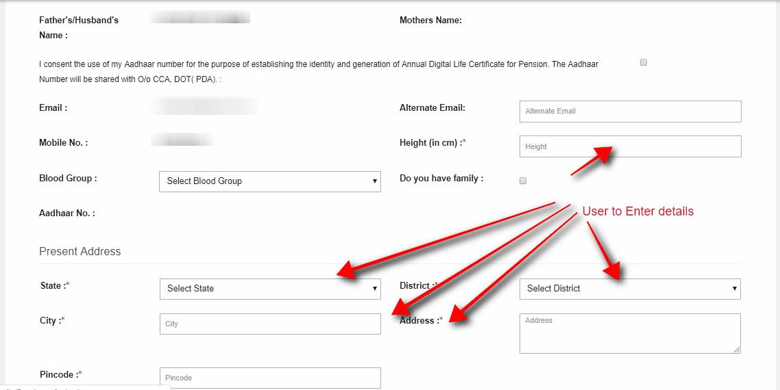
Personal Details Tab

Slide 7
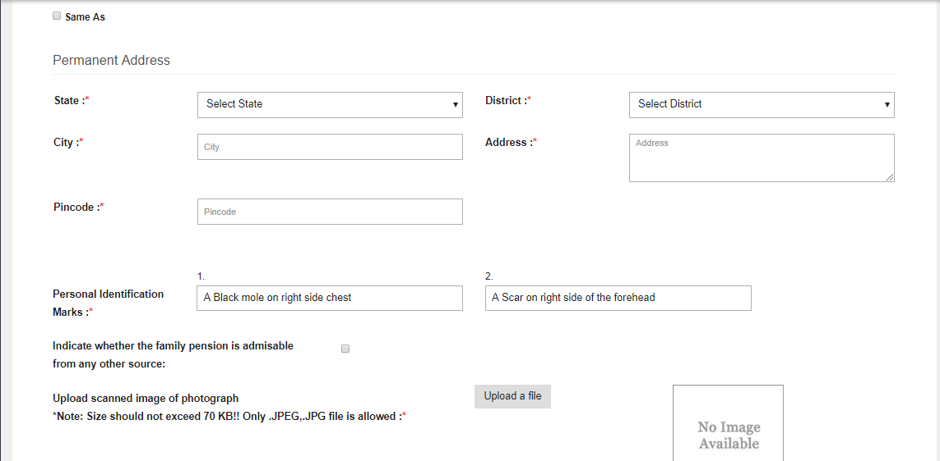
Personal Details Tab

Slide 8
Personal Details Tab
Notes:
More attention

Slide 9
Personal Details Tab
The retiree must take note of the following while filling up the details:
While filling the Address, only alphanumeric characters should be entered and special characters should be avoided. Retiree should use spaces if needed.
The following photographs need to be uploaded
One single photo of the retiree
One photo of the retiree’s signature
One joint photograph of retiree and spouse.
Photographs should be clear and of good quality
In case the Permanent address is same as the Present address, then check the “Same as” checkbox given in the page, which will automatically replicate the Present Address in the Permanent Address fields
Retiree should adhere to the size of the photographs mentioned on the page, in front of the Photo uploading box.
Extra care must be taken while uploading the images. Once uploaded, it should be ensured that the correct photo has been uploaded in the correct box.

Slide 10
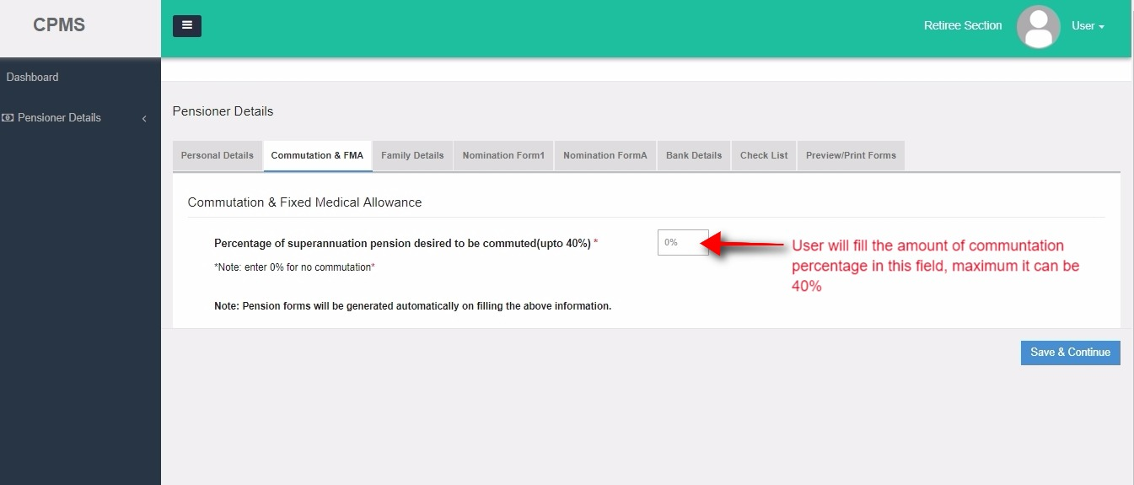
Commutation & FMA Tab
The percentage of commutation will be zero by default and cannot be edited.

Slide 11
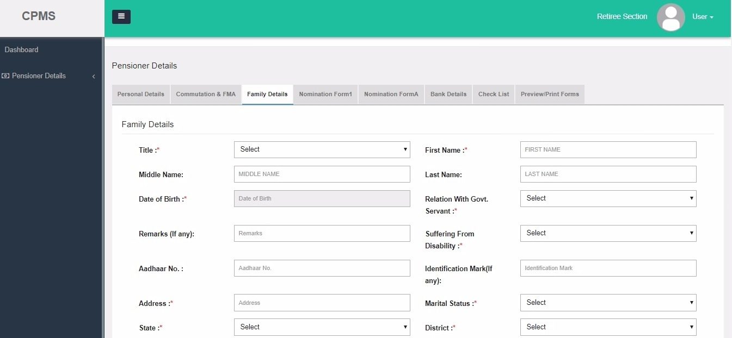
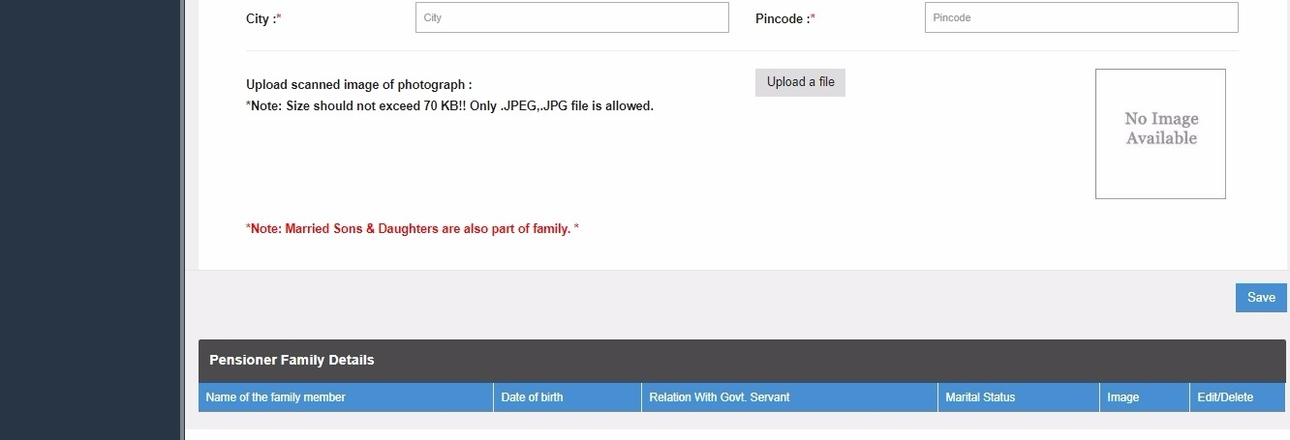
Family Details Tab
Notes:
More attention

Slide 12
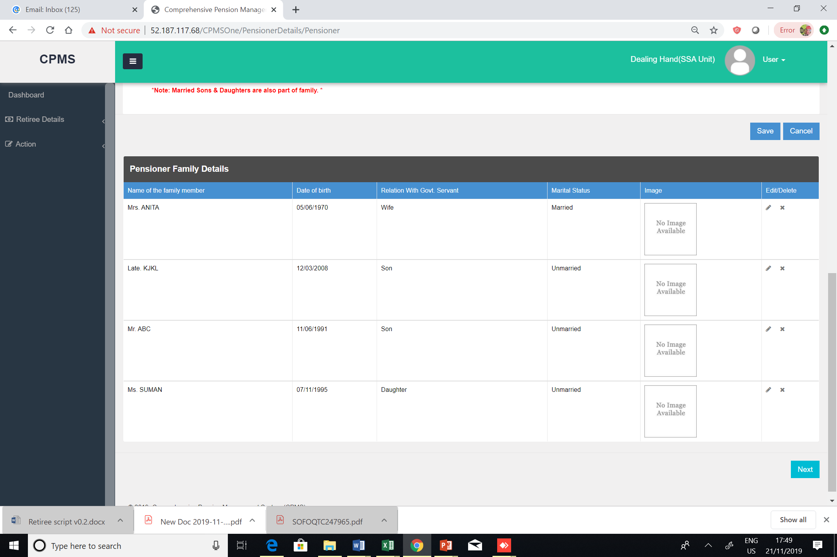
Family Details Tab

Slide 13
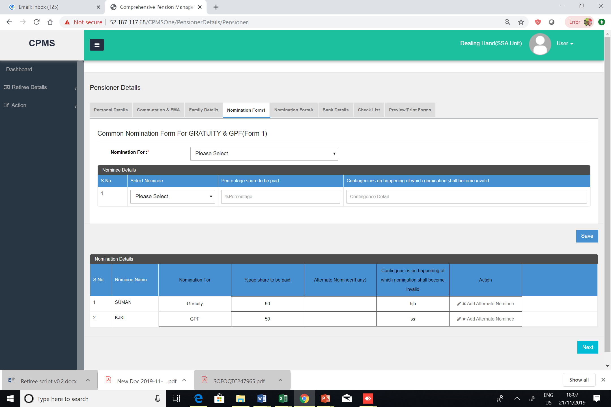
Nomination Form 1 Tab

Slide 14
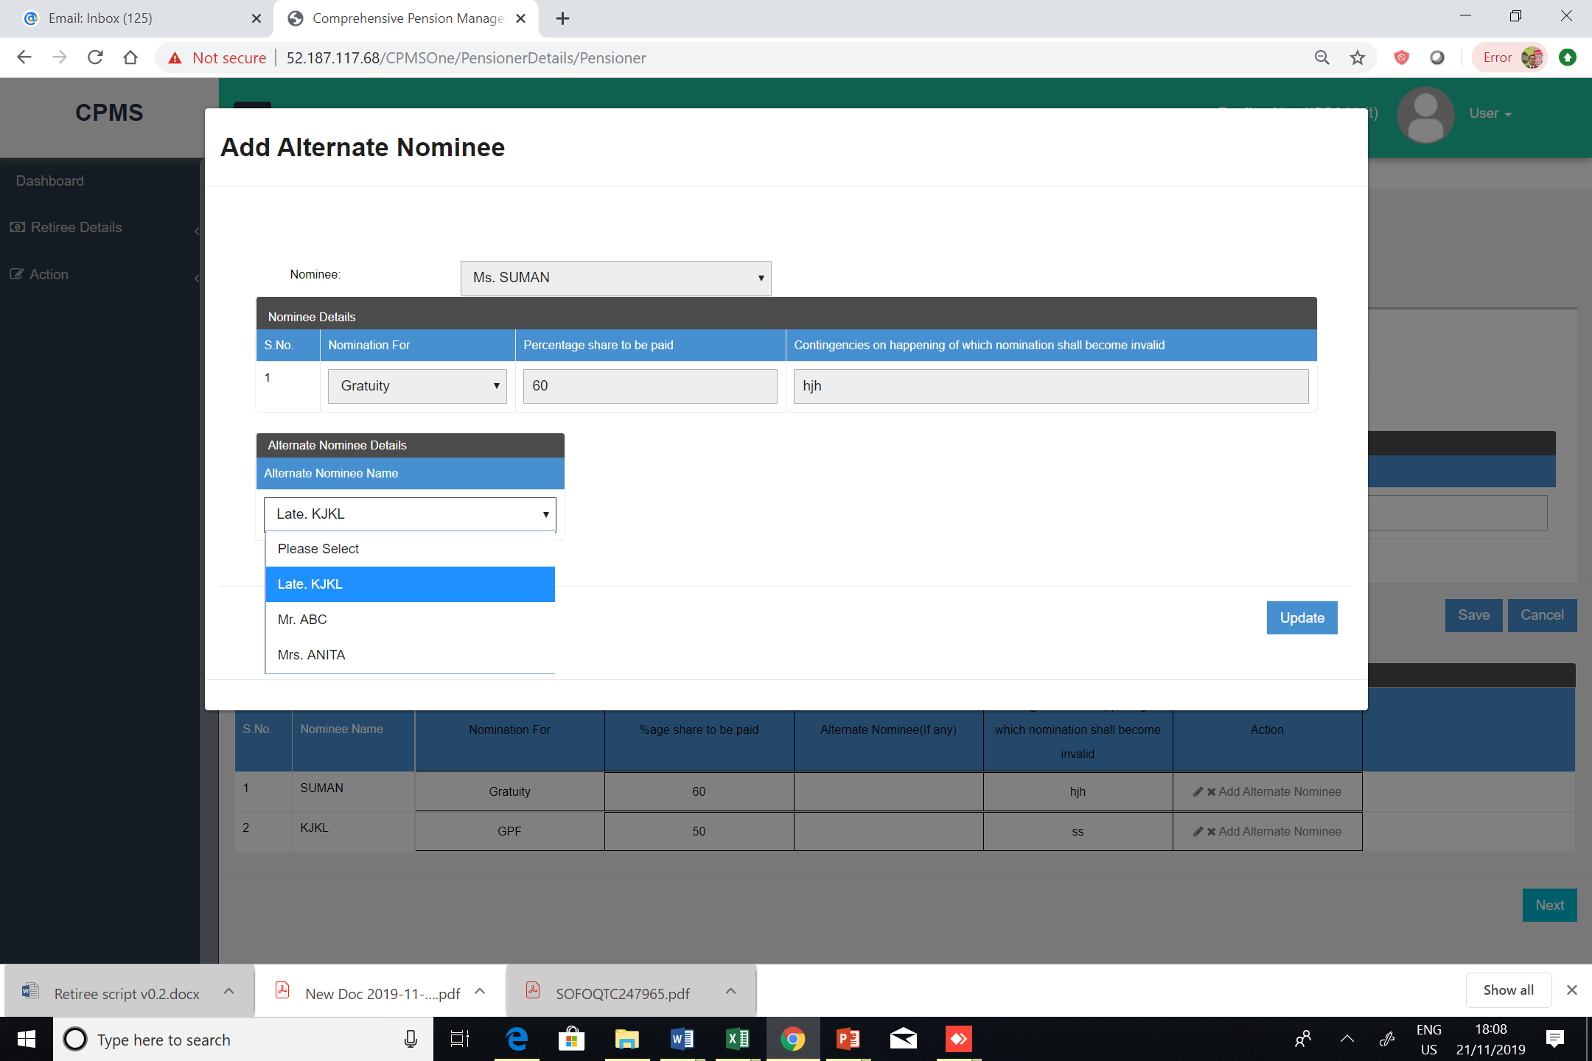
Nomination Form 1 Tab

Slide 15
Nomination Form A Tab

Slide 16
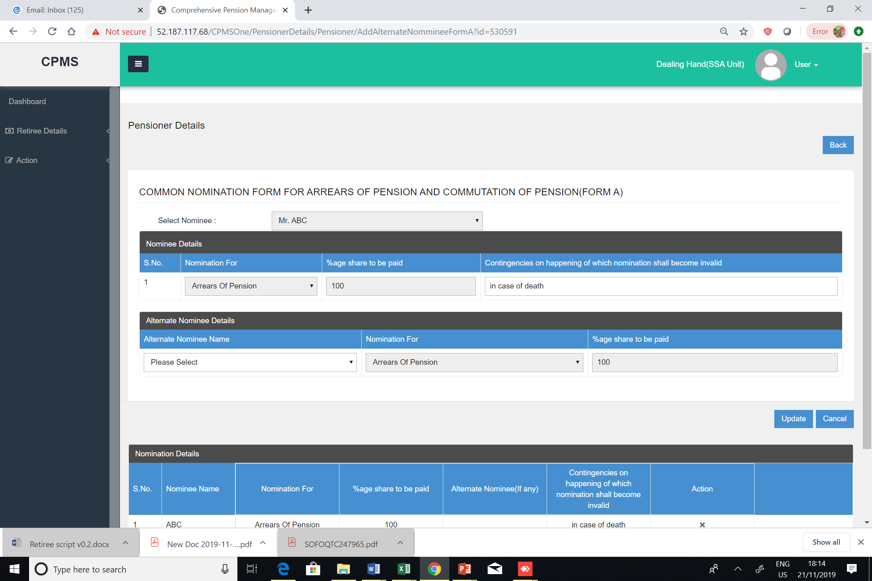
Nomination Form A Tab

Slide 17
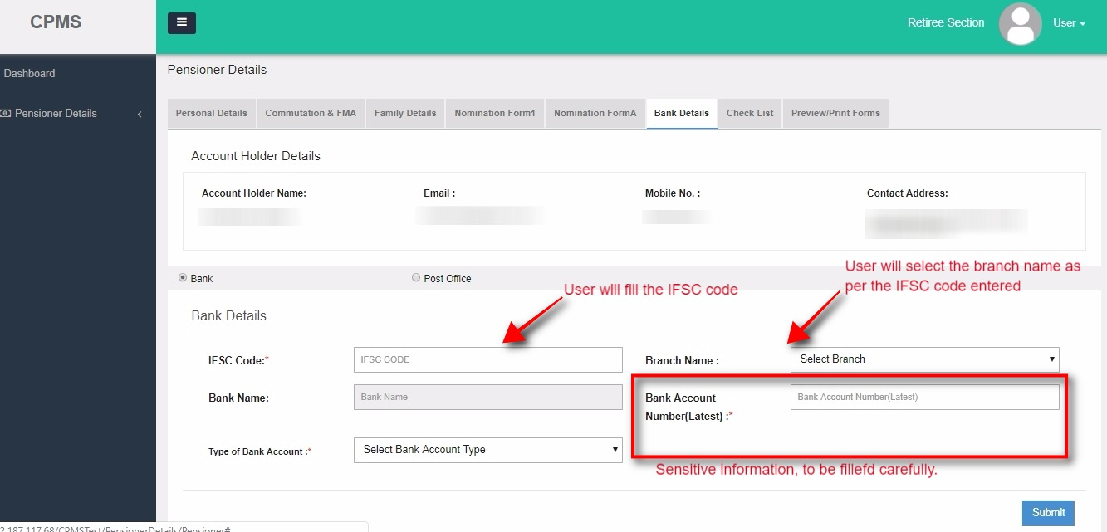
Bank Details Tab
Since pension and terminal benefits will be credited into this account bank account details must be filled with extreme care
Notes:
More attention

Slide 18
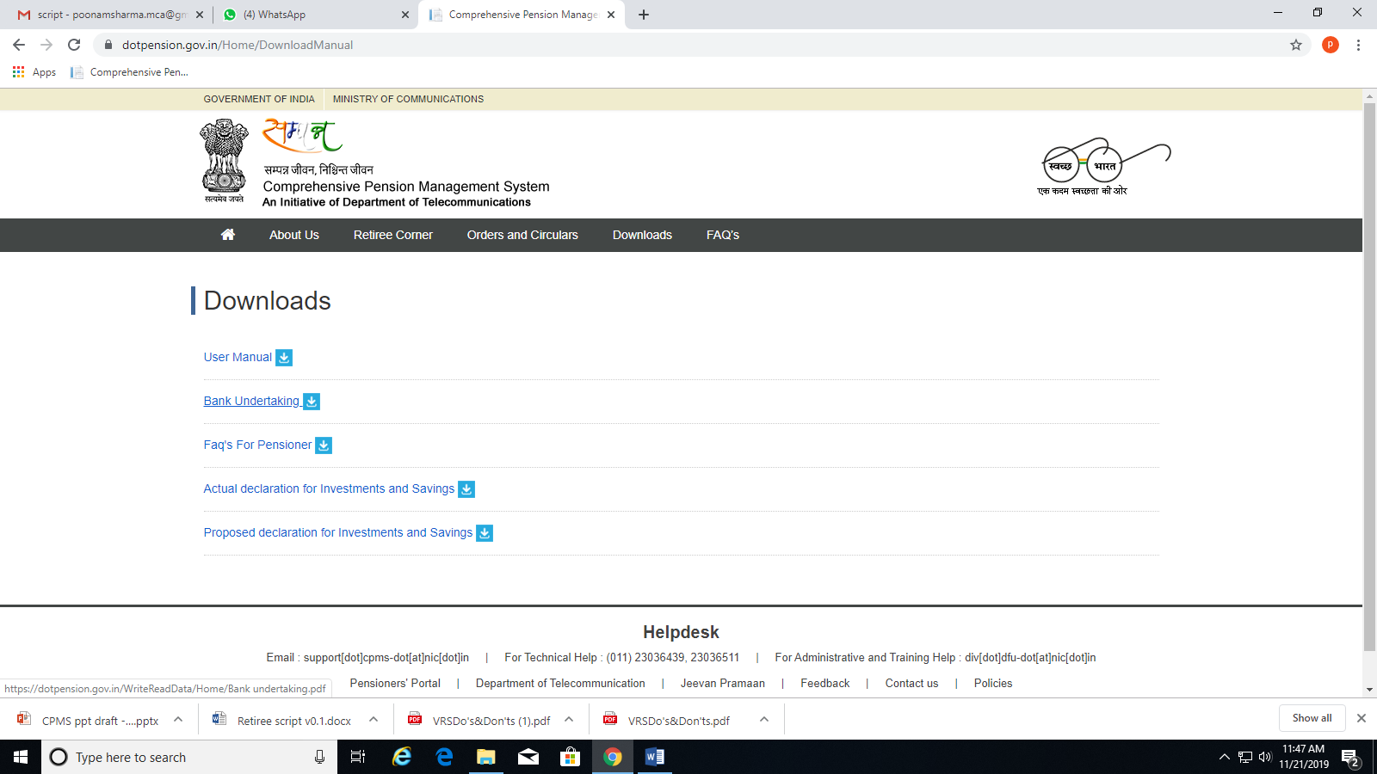
Download Bank Undertaking

Slide 19
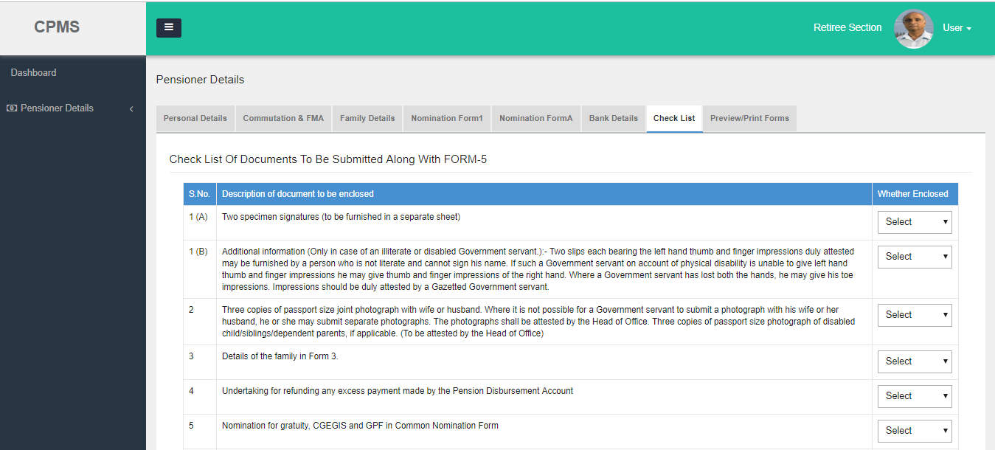
Check List Tab

Slide 20
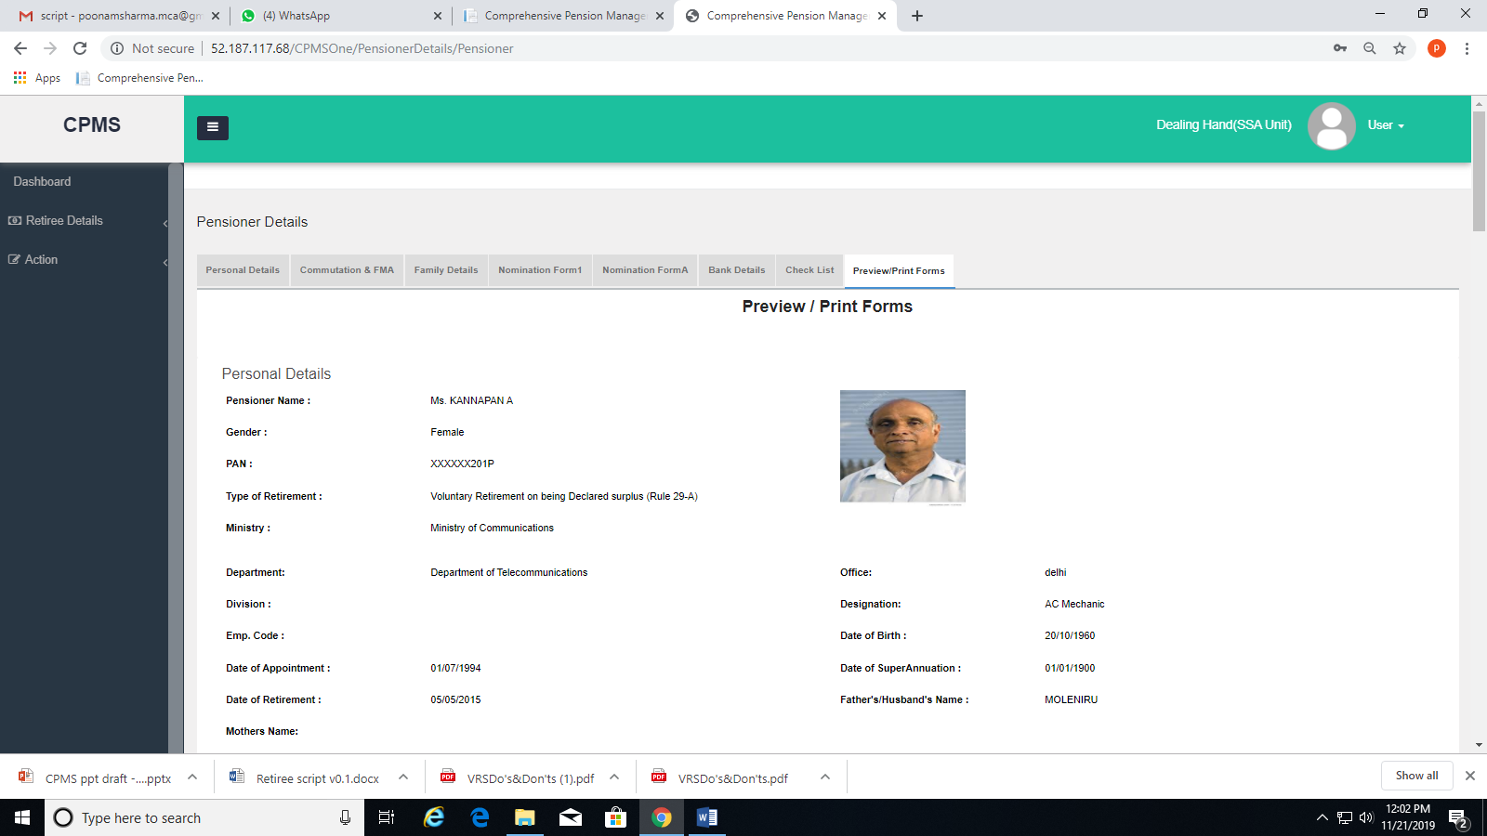
Print/Preview Forms Tab

Slide 21
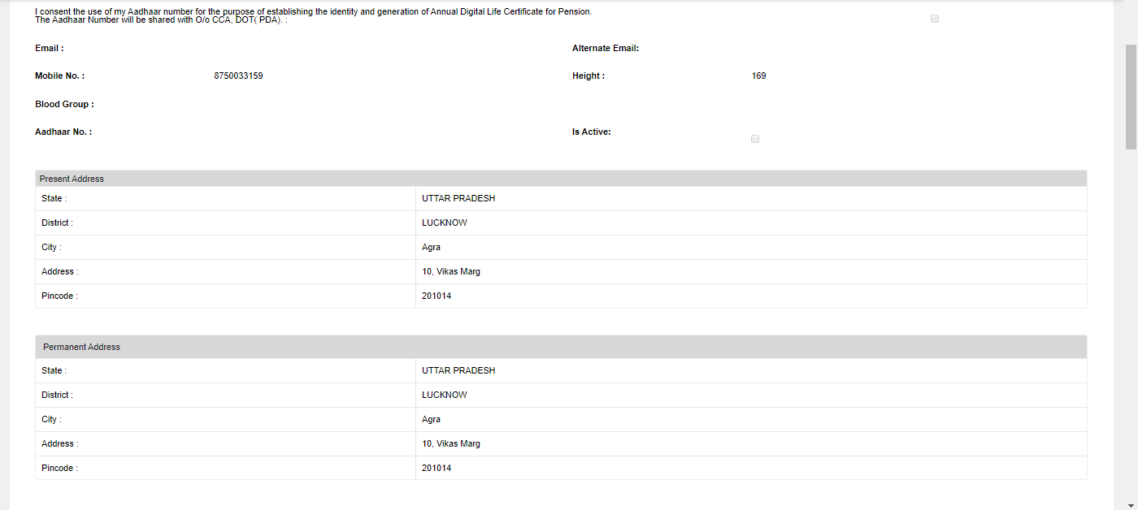
Print/Preview Forms Tab

Slide 22
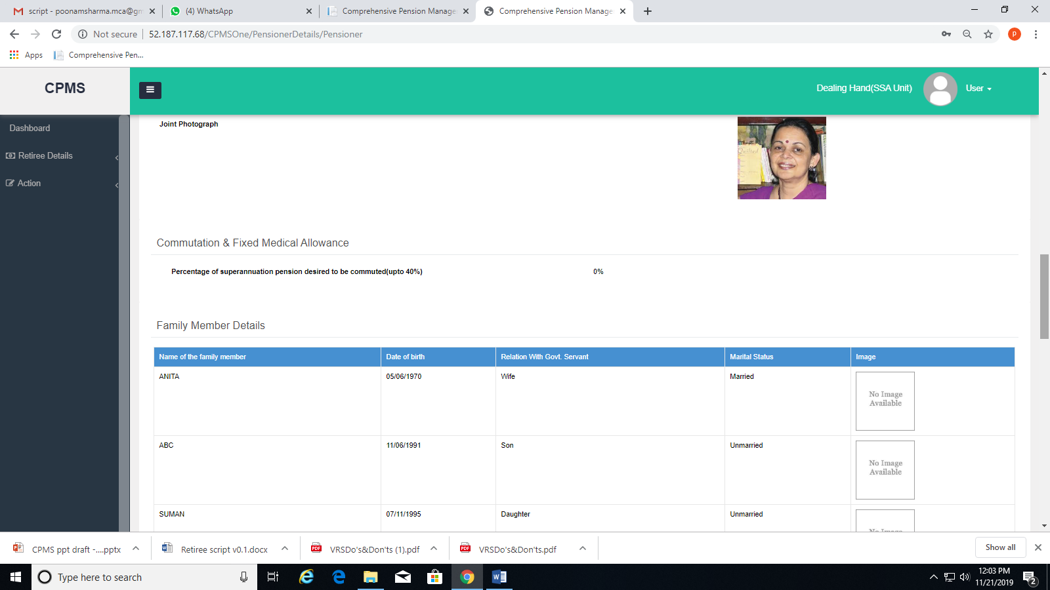
Print/Preview Forms Tab

Slide 23
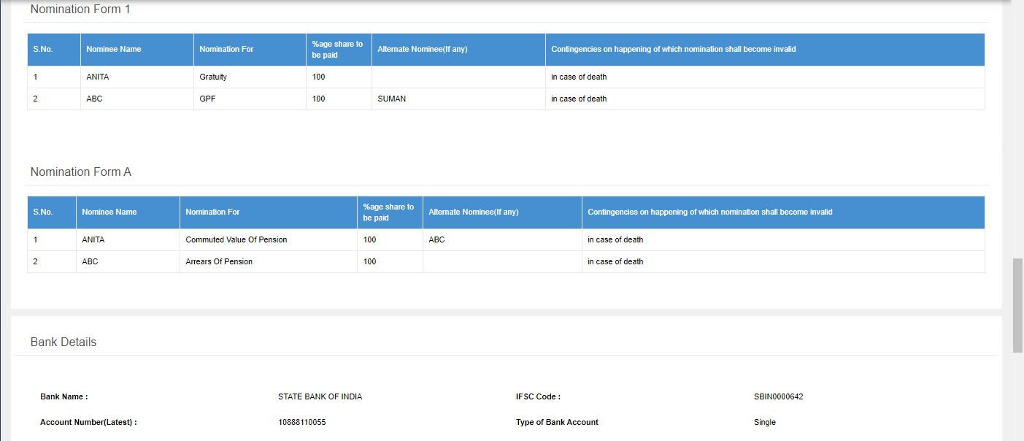
Print/Preview Forms Tab

Slide 24
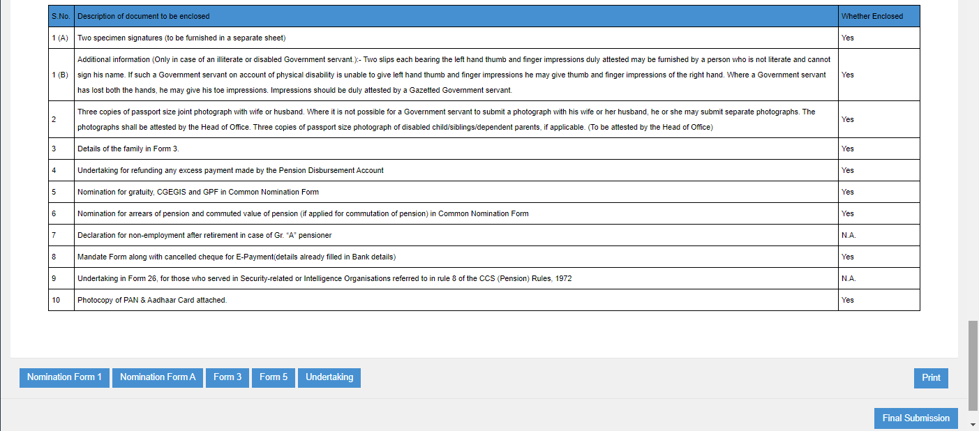
Print/Preview Forms Tab

Slide 25
Forms and Documents
The following are system generated:
Form 3
Form 5
Nomination Form 1
Nomination Form A
The following have to be submitted in physical copies:
Bank Undertaking has to be downloaded, signed and then uploaded
Two specimen signatures
Two slips with right and left thumb impression if applicable
Three Single/joint(as applicable) photographs with spouse
Mandate Form
PAN and Aadhaar card copies
Personal Identification Slip
All retirees are advised to be ready with all the listed documents before filling the information in the SAMPANN system.

Slide 26
Data Corrections
In case any corrections have to be done after Final Submission, the retiree must immediately inform the concerned BSNL office
In case the BSNL office detects a correction in the details filled by the retiree, the retiree will be intimated by the office and he/she will have to submit again

Slide 27
Other Features of Dashboard
Pensioners shall have access to:
Digitally signed Authority letters for Terminal benefits and pension
Monthly ledger
Option to submit Investment and Saving declarations
Option to Lodge grievances

Slide 28
Dashboard feature

Slide 29
Thanks
https://dotpension.gov.in/Login/Index

